Slide 1
Table of Content
Machine Learning in Health Care
Problem statement
Data understanding
EDA
Data Preprocessing
Modelling
Evaluation and Interpretability of model
Conclusion
Q/A

Slide 2
Machine Learning in Health care !
Why it is possible?
Digitization
Advacement in computation power
Curated Algorithm
How is it reliable?
Algorithms are transparent
Based on real world cases
Domain expertise included
Why is it better ?
cheaper
Easily available to all
Takes less time training , compared to a medical professional

Slide 3
Problem Statement
Given the cardio vascular data , where you have health characteristics as your fields you want to make a machine learning model , which best gives you the risk of getting a Cardia vascular attack in the coming 10 years.

Slide 4
Understanding our data
The dataset is from an ongoing cardiovascular study on residents of the town of Framingham,Massachusetts.
The dataset provides the patients’ information.
It includes over 4,000 records and 15 attributes.
• 10-year risk of coronary heart disease CHD(binary: “1”, means “Yes”, “0” means “No”) -DV

Slide 5
Understanding the Data – (contd)
Demographic:
Sex: male or female("M" or "F")
Age: Age of the patient;(Continuous - Although the recorded ages have been truncated to whole numbers, the concept of age is continuous)
Medical( history):
BP Meds: whether or not the patient was on blood pressure medication (Nominal)
Prevalent Stroke: whether or not the patient had previously had a stroke (Nominal)
Prevalent Hyp: whether or not the patient was hypertensive (Nominal)
Diabetes: whether or not the patient had diabetes (Nominal)

Slide 6
Medical(current):
Tot Chol: total cholesterol level (Continuous)
Sys BP: systolic blood pressure (Continuous)
Dia BP: diastolic blood pressure (Continuous)
BMI: Body Mass Index (Continuous)
Heart Rate: heart rate (Continuous - In medical research, variables such as heart rate though in fact discrete, yet are considered continuous because of large number of possible values.)
Glucose: glucose level (Continuous)
Behavioral:
is_smoking: whether or not the patient is a current smoker ("YES" or "NO")
Cigs Per Day: the number of cigarettes that the person smoked on average in one day.(can be considered continuous as one can have any number of cigarettes, even half a cigarette.)

Slide 7
Cleaning
Checking Null values
Checking Data Types
EDA
Univariate
Bivariate
Multivariate
Handling Missing Values
Preprocessing
Binning
Transformation
Scaling
Logistic Regression
Evaluation
Model fit
SVM
Evaluation
XGBoost
Evaluation

Slide 8
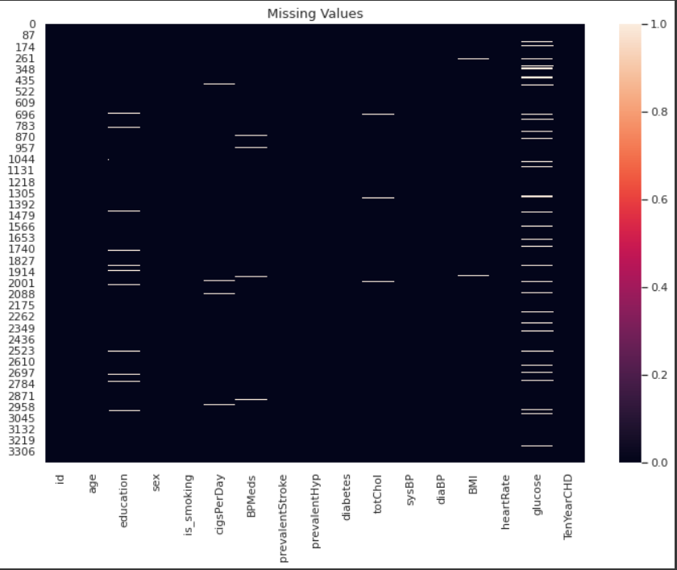
Missing Values
- There are some null values in our Data that we will have to deal with

Slide 9
EDA

Slide 10
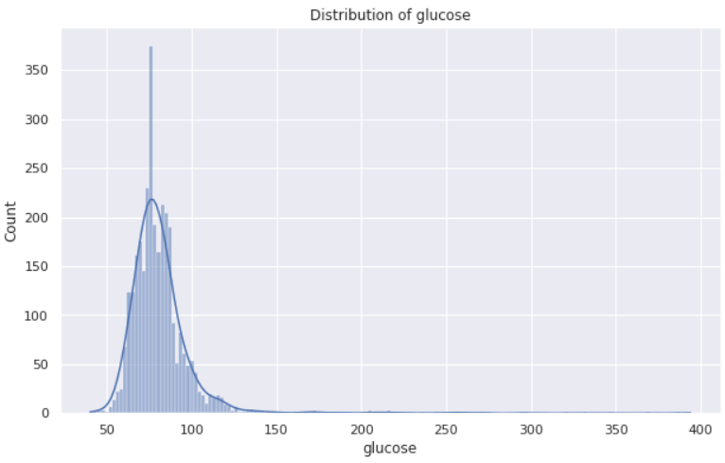
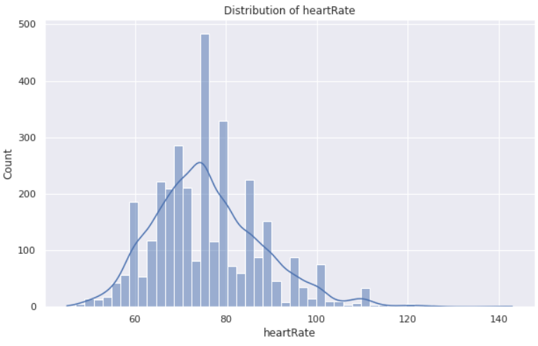
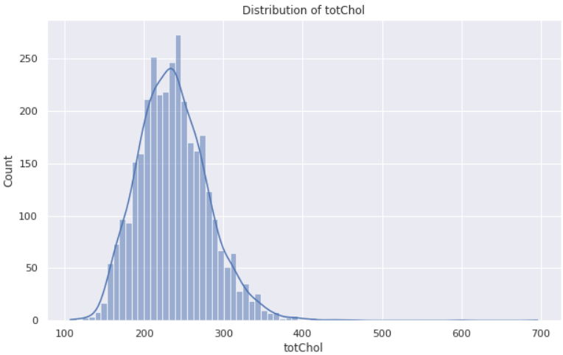
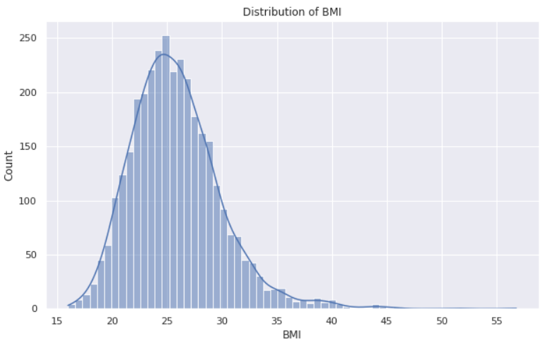
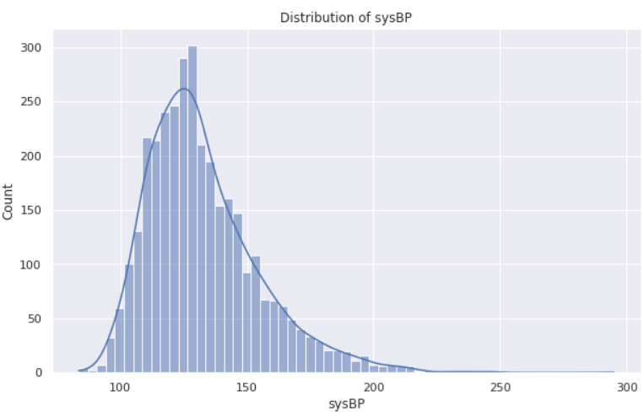
Checking for Distribution and skewness in the continuous independent variable

Slide 11
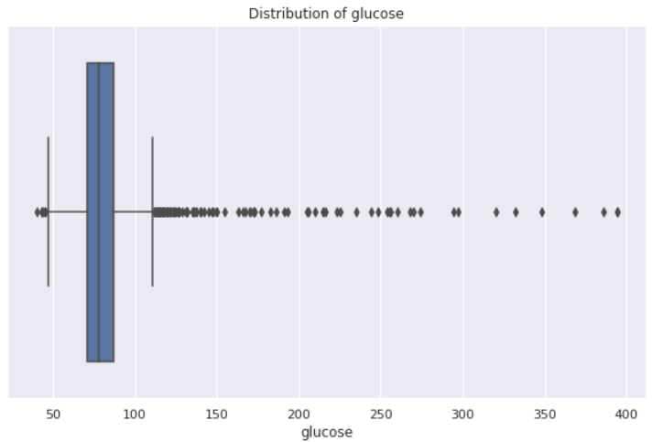
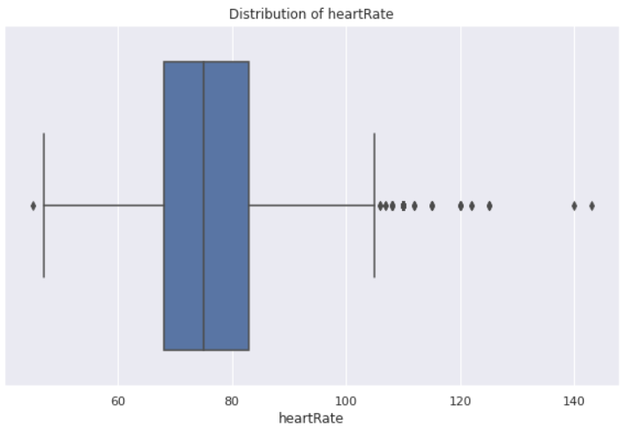
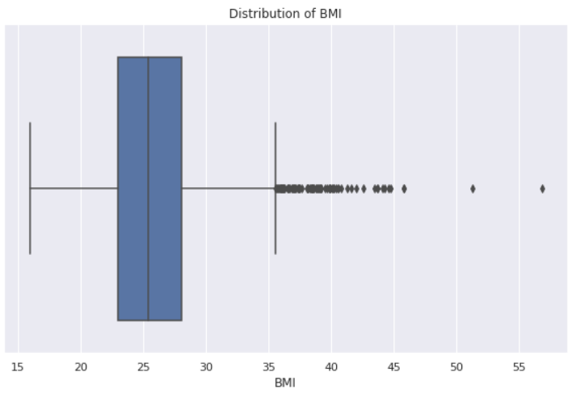
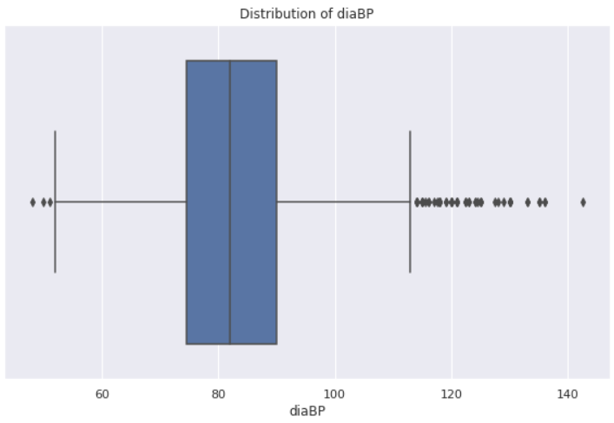
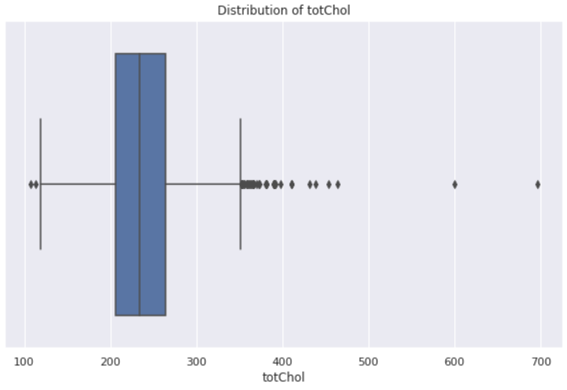
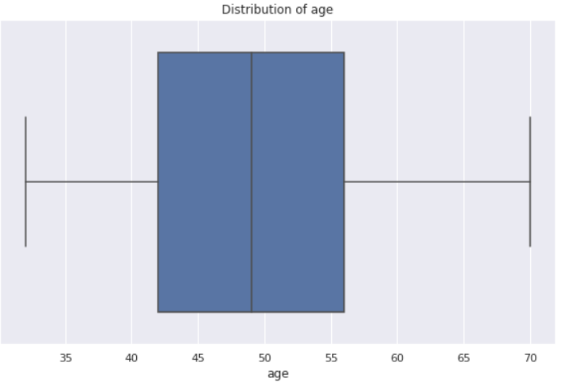
Checking for outliers in the Data

Slide 12
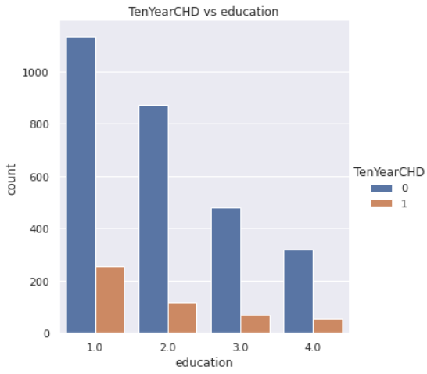
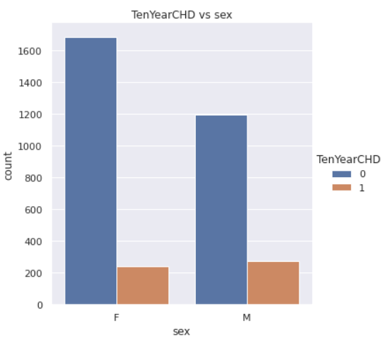
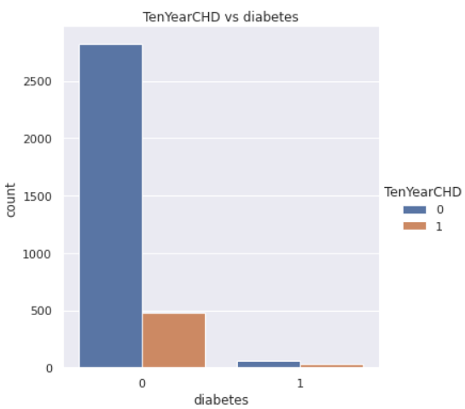
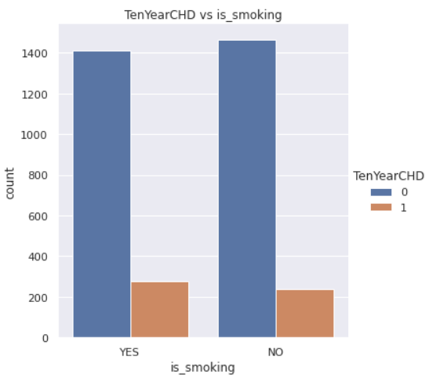
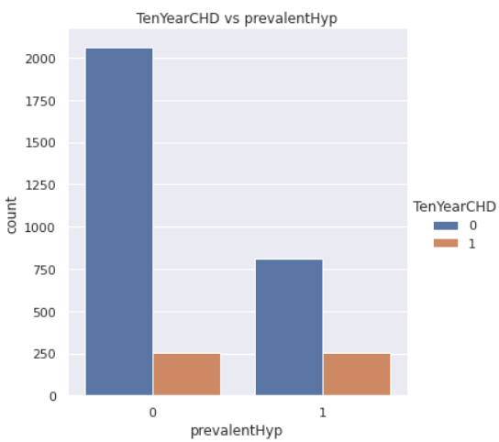

Slide 13
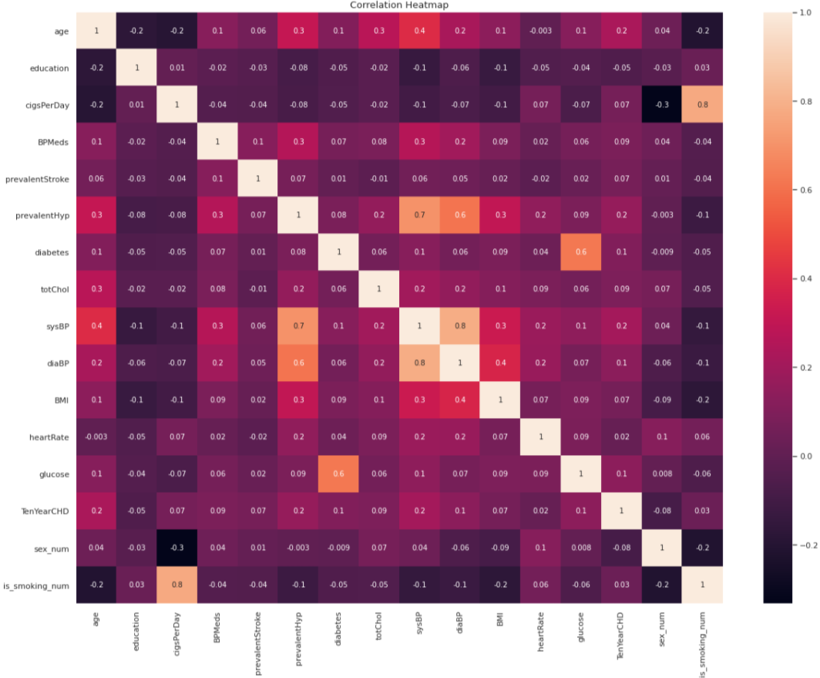

Slide 14
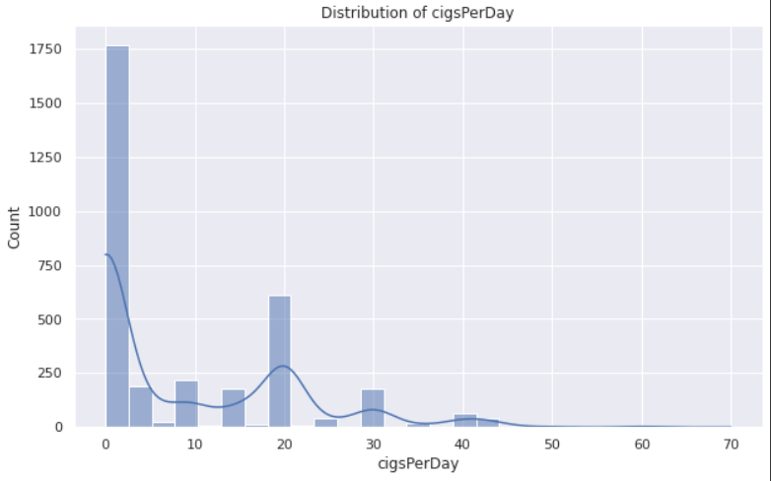
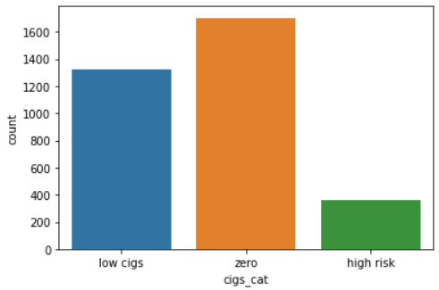
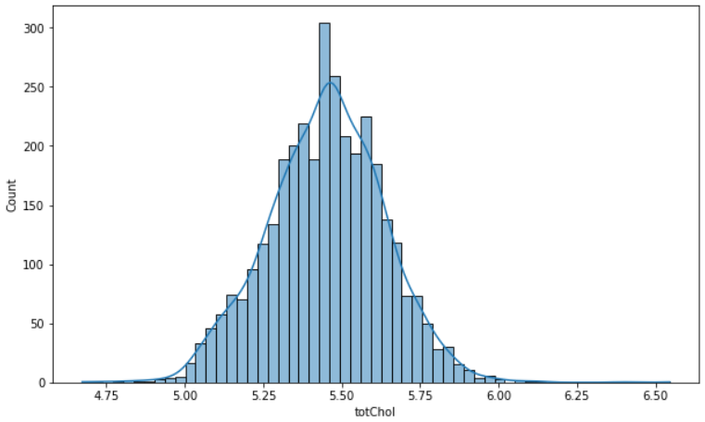
Binning to convert continuous to categorical variable
Using Log Transformation to deal with Skewness of the Data

Slide 15
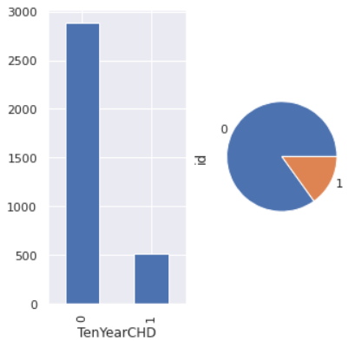
Handling Class imbalance
A High Class imbalance is present in our Data
Following technique can used to deal with class imbalance
Random Under Sampling
Random Over Sampling
SMOTE
Class weights

Slide 16
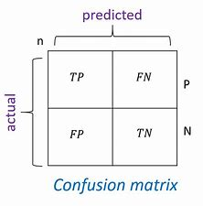
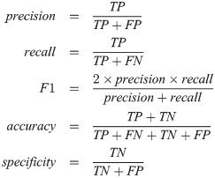
Choosing Right Evaluation Metrics
Right Metrics for evaluation depends on the Domain
Different evaluation metric can be taken into account , based on the Problem at hand.
Here we have taken Recall as our main evaluation metrics
Recall measures the sensitivity of the model
We will aim , that our model should not Misclassify any minority Point

Slide 17
Modelling

Slide 18
Logistic Regression
Parameter
C=1, class_weight=None, dual=False, fit_intercept=True, intercept_scaling=1, l1_ratio=None, max_iter=100, multi_class='auto', n_jobs=None, penalty='l2', random_state=None, solver='lbfgs', tol=0.0001, verbose=0, warm_start=False
Evaluation

Slide 19
Support Vector Machine
Parameters
C=1.0, break_ties=False, cache_size=200, class_weight={0: 1, 1: 6}, coef0=0.0, decision_function_shape='ovr', degree=3, gamma='scale', kernel='rbf', max_iter=-1, probability=True, random_state=None, shrinking=True, tol=0.001, verbose=False
Evaluation

Slide 20
Decsion Tree
Parameters
Evaluation

Slide 21
Random Forest
Parameter
Evaluation

Slide 22
Xgboost
Parameter
(base_score=0.5, booster='gbtree', colsample_bylevel=1, colsample_bynode=1, colsample_bytree=0.7725876038663544, gamma=4.128689439174278, learning_rate=0.1, max_delta_step=0, max_depth=9, min_child_weight=3.0, missing=None, n_estimators=100, n_jobs=1, nthread=None, objective='binary:logistic', random_state=1, reg_alpha=176.0, reg_lambda=0.44453811221465295, scale_pos_weight=6, seed=None, silent=None, subsample=1, verbosity=1)
Evaluation

Slide 23
Evaluation Table

Slide 24
Model interpretation/feature importance

Slide 25
Summary

Slide 26
Conclusion

Slide 27
Q/A

